Slide 1

50.039 Theory and Practice of Deep Learning W8-S3 Word Embedding Biases, Evaluation, Attention and Transformers
Matthieu De Mari

Slide 2
About this week (Week 8)
Why are embeddings an essential component of Neural Networks (NNs)?
Why are good embeddings difficult to produce?
What are the conventional approaches to embeddings in NLP? What can we learn from these approaches?
What are the typical issues with embeddings and how do we address them?
State-of-the-art of current embedding problems, and open questions in research.

Slide 3
About this week (Week 8)
How do we evaluate the quality/performance of an embedding?
Can embeddings be biased?
Can we help the neural networks identify the important parts of the context to focus on?
What is attention in Neural Networks? What are transformers in Neural Networks?
What are the typical uses for attention these days?
What are the limits of attention and the current research directions on this topic?

Slide 4
In the last episode…
We have discussed the embedding problem, and its aspects in Natural Language Processing.
Many approaches can be used to obtain word embedding.
Unsupervised: CBoW & SkipGram (2013), GloVe (2014), FastText (2018), ELMo (2018).
Question: What makes a word embedding better than another? How do we measure the performance of an embedding?

Slide 5
Measuring Embeddings Performance
Evaluating the performance of an embedding is a difficult task and still an open question in research [Schnabel2015].
Reason: it is very difficult to come up with a performance measure to objectively evaluate the quality of a word embedding.
Overall, two big families of approaches:
Extrinsic methods
Intrinsic Methods

Slide 6
Measuring Embeddings Performance
Method #1 (Extrinsic Evaluation):
Methods of extrinsic evaluation are based on the ability of word embeddings to be used as the feature vectors of supervised machine learning algorithms.
The more able a word embedding is on a given (complex) task, the better it might be.

Slide 7
Measuring Embeddings Performance
Method #1 (Extrinsic Evaluation):
Methods of extrinsic evaluation are based on the ability of word embeddings to be used as the feature vectors of supervised machine learning algorithms.
The more able a word embedding is on a given (complex) task, the better it might be.
Typically, training a CBoW requires to predict a missing word, in the middle of a given sentence.
This is an easier task to train on, compared to predicting the possible context words for a given single word (SkipGram)
For this reason, we often assume that SkipGram > CBoW.

Slide 8
Measuring Embeddings Performance
Method #1 (Extrinsic Evaluation):
Methods of extrinsic evaluation are based on the ability of word embeddings to be used as the feature vectors of supervised machine learning algorithms.
The more able a word embedding is on a given (complex) task, the better it might be.
In general, we train an embedding on a task and extract a layer from our Neural Network, corresponding to the embedding.
This embedding is then reused on another task layer on (transfer learning).
For this reason, it is often preferable to check how good the embedding is on the second task.

Slide 9
Measuring Embeddings Performance
Method #1 (Extrinsic Evaluation):
Methods of extrinsic evaluation are based on the ability of word embeddings to be used as the feature vectors of supervised machine learning algorithms.
The more able a word embedding is on a given (complex) task, the better it might be.
Researchers have identified a set of typical NLP tasks and datasets on which we need word embeddings [Schnabel2015], e.g.
Sentiment Analysis
Translation
Etc.
These have often been used as reference for measuring the performance of a given word embedding.

Slide 10
Measuring Embeddings Performance
Method #2 (Intrinsic Evaluation):
Methods of intrinsic evaluation are experiments in which word embeddings are compared with human judgments on words relations.
Typically, we will rely on a human expert to judge whether the word embedding is good or not.

Slide 11
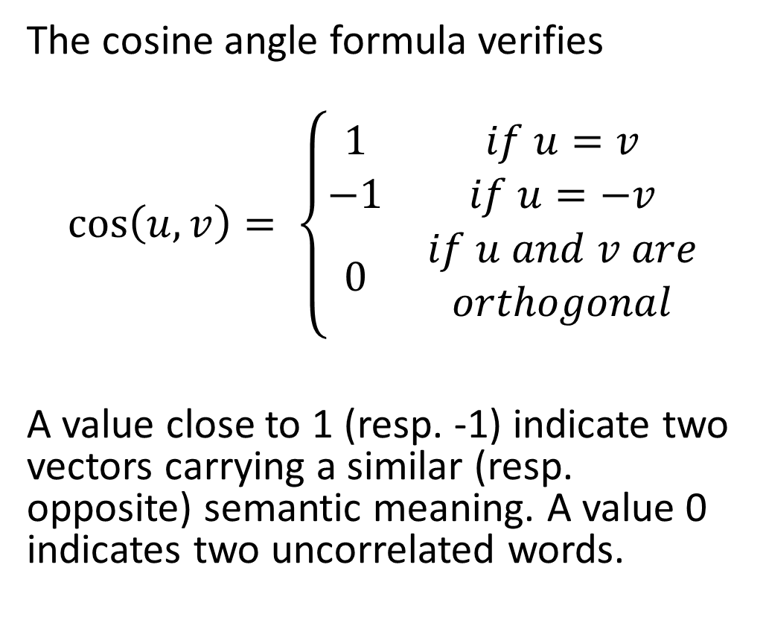
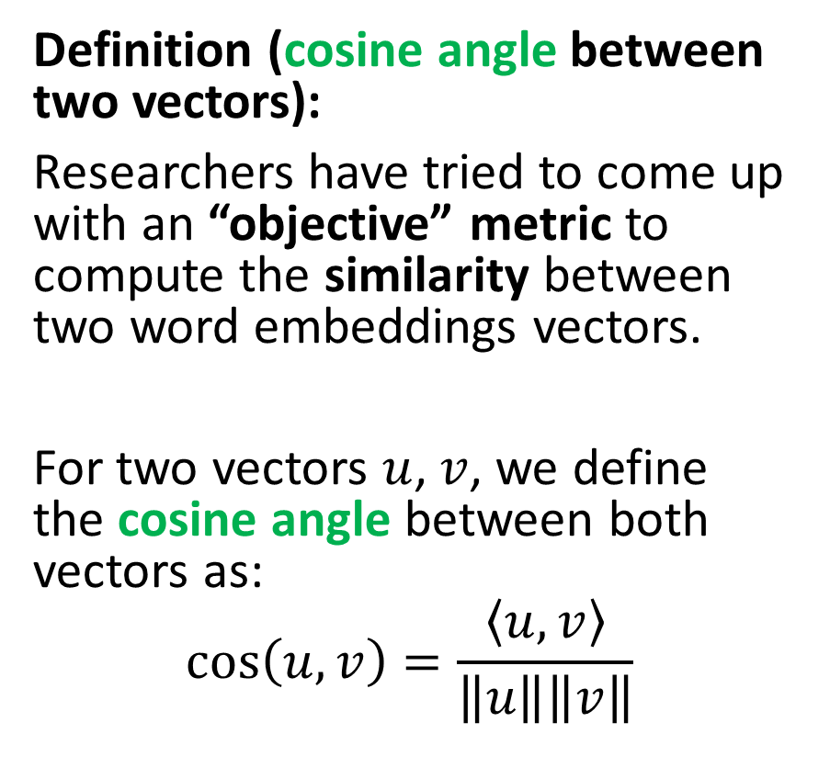
Measuring Embeddings Performance
Definition (cosine angle between two vectors):
Researchers have tried to come up with an “objective” metric to compute the similarity between two word embeddings vectors.
For two vectors $u$, $v$, we define the cosine angle between both vectors as:
$$\cos\left(u, v\right)=\frac{\left\langle u,v\right\rangle }{\left\|u\right\|\left\|v\right\|}$$
The cosine angle formula verifies
$$\cos\left(u,v\right)= \left\{\begin{matrix}1 & if u=v \\ −1 & if u=−v \\ 0 & \begin{aligned}if u and v are \\ orthogonal\end{aligned}\end{matrix}\right.$$
A value close to 1 (resp. -1) indicate two vectors carrying a similar (resp. opposite) semantic meaning. A value 0 indicates two uncorrelated words.

Slide 12
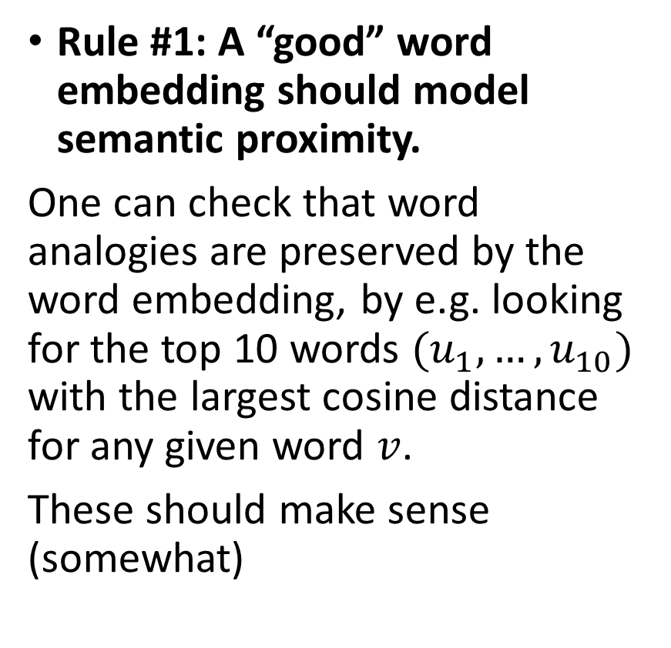
Measuring Embeddings Performance
Rule #1: A “good” word embedding should model semantic proximity.
One can check that word analogies are preserved by the word embedding, by e.g. looking for the top 10 words $(u_{1},…,u_{10})$ with the largest cosine distance for any given word $v$.
These should make sense (somewhat)

Slide 13
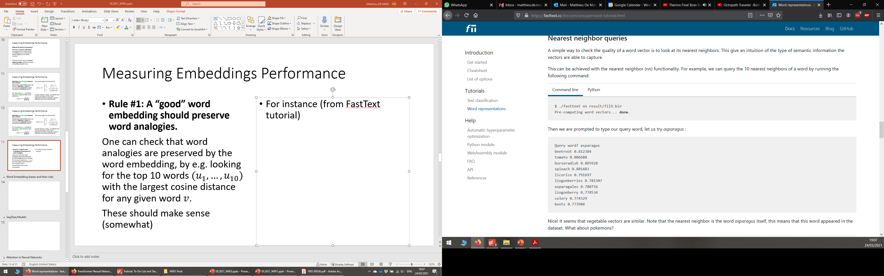
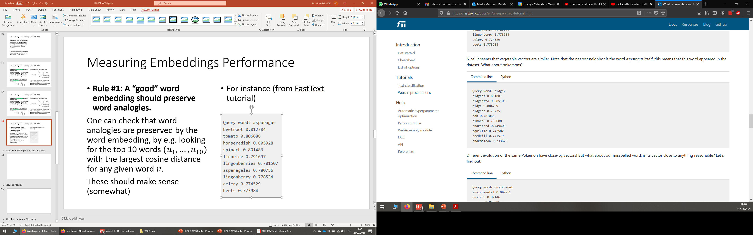
Measuring Embeddings Performance
Rule #1: A “good” word embedding should model semantic proximity.
One can check that word analogies are preserved by the word embedding, by e.g. looking for the top 10 words $(u_{1},…,u_{10})$ with the largest cosine distance for any given word $v$.
These should make sense (somewhat)
For instance (from the FastText tutorial https://fasttext.cc/docs/en/unsupervised-tutorial.html)

Slide 14
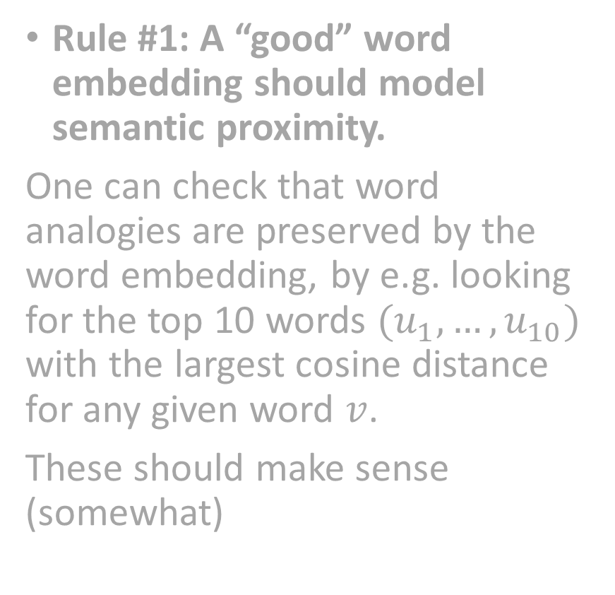
Measuring Embeddings Performance
Rule #1: A “good” word embedding should model semantic proximity.
One can check that word analogies are preserved by the word embedding, by e.g. looking for the top 10 words $(u_{1},…,u_{10})$ with the largest cosine distance for any given word $v$.
These should make sense (somewhat)
For instance (from the FastText tutorial https://fasttext.cc/docs/en/unsupervised-tutorial.html)
Are these top10 lists good or bad answers?
Your answer to this question will probably be very subjective and not a reliable performance evaluation metric...!

Slide 15
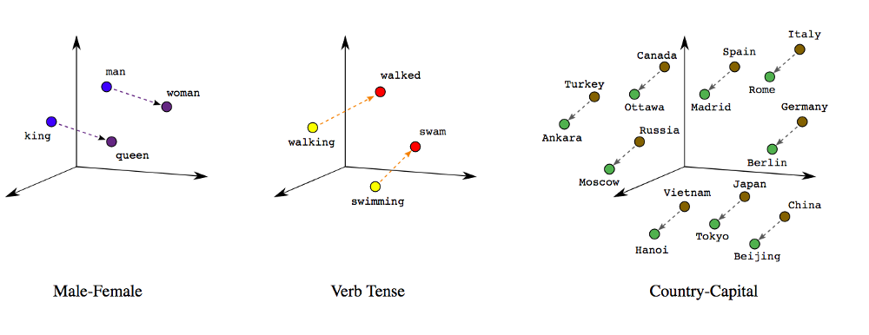
Measuring Embeddings Performance
Rule #2: A “good” word embedding should preserve word analogies.
Word analogies are sentences reading as “A is to B, what C is to D”, with A, B, C and D being four words.

Slide 16
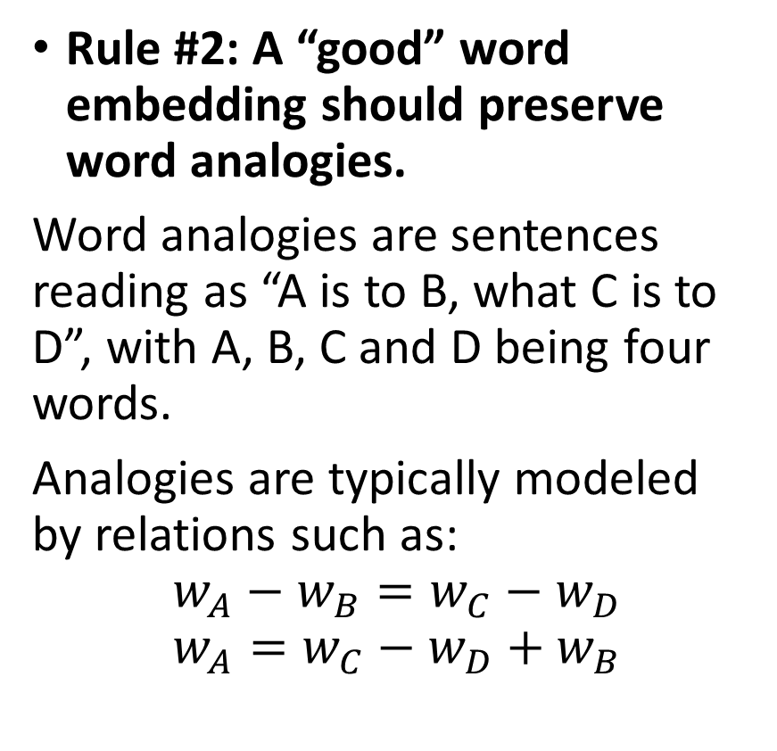
Measuring Embeddings Performance
Rule #2: A “good” word embedding should preserve word analogies.
Word analogies are sentences reading as “A is to B, what C is to D”, with A, B, C and D being four words.
Analogies are typically modeled by relations such as:
$$w_{A}−w_{B}=w_{C}−w_{D}$$
$$w_{A}=w_{C}−w_{D}+w_{B}$$

Slide 17
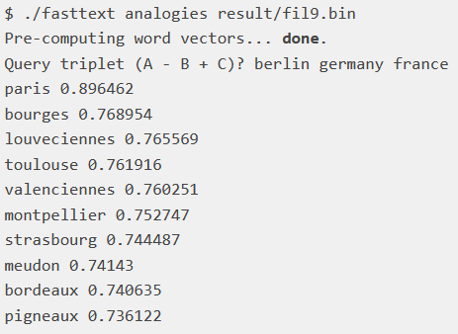
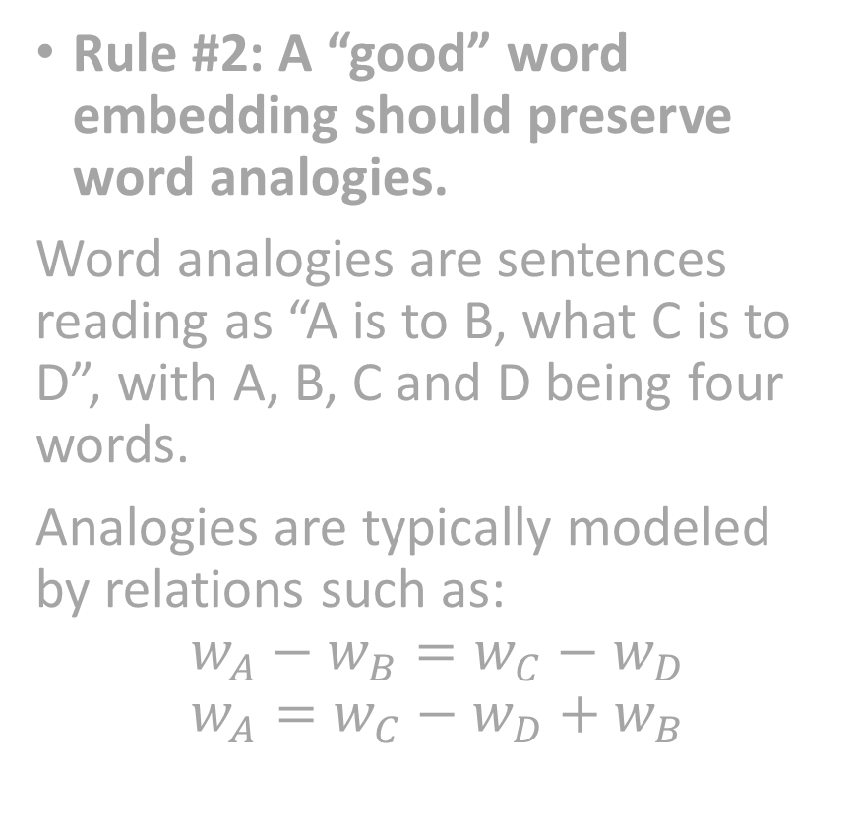
Measuring Embeddings Performance
Rule #2: A “good” word embedding should preserve word analogies.
Word analogies are sentences reading as “A is to B, what C is to D”, with A, B, C and D being four words.
Analogies are typically modeled by relations such as:
$$w_{A}−w_{B}=w_{C}−w_{D}$$
$$w_{A}=w_{C}−w_{D}+w_{B}$$
For instance (from the FastText tutorial https://fasttext.cc/docs/en/unsupervised-tutorial.html)
Is this top10 list containing good or bad answers?
Your answer to this question will (again!) probably be very subjective and not a reliable performance evaluation metric...!

Slide 18
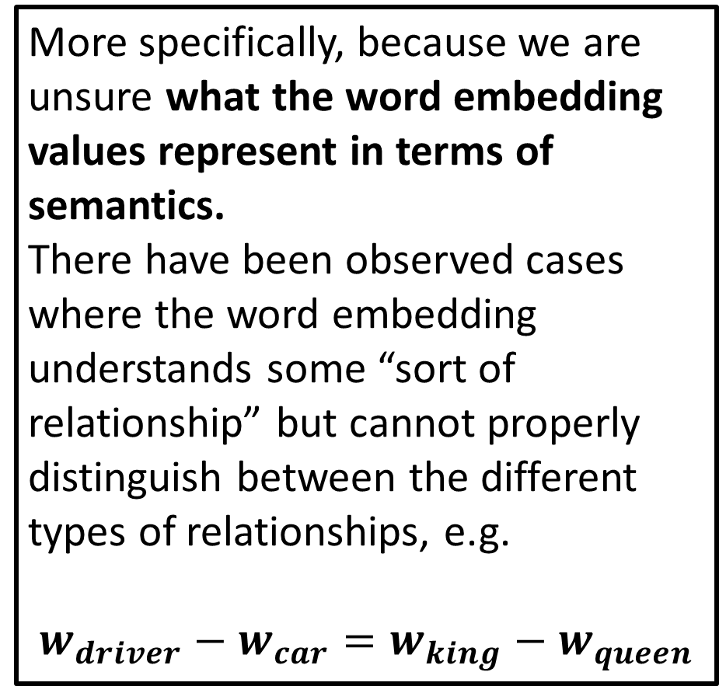
Measuring Embeddings Performance
More specifically, because we are unsure what the word embedding values represent in terms of semantics.
There have been observed cases where the word embedding understands some “sort of relationship” but cannot properly distinguish between the different types of relationships, e.g.
$$w_{driver}−w_{car}=w_{king}−w_{queen}$$
Rule #2: A “good” word embedding should preserve word analogies.
Word analogies are sentences reading as “A is to B, what C is to D”, with A, B, C and D being four words.
Analogies are typically modeled by relations such as:
$$w_{A}−w_{B}=w_{C}−w_{D}$$
$$w_{A}=w_{C}−w_{D}+w_{B}$$
For instance (from the FastText tutorial https://fasttext.cc/docs/en/unsupervised-tutorial.html)
Is this top10 list containing good or bad answers?
Your answer to this question will (again!) probably be very subjective and not a reliable performance evaluation metric...!

Slide 19
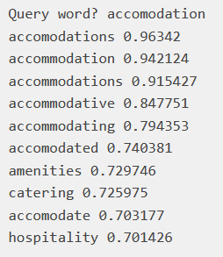
Measuring Embeddings Performance
Rule #3: A “good” word embedding should be able to operate on variations on the words (color/colour, typos, plural forms, conjugation, etc.).
For instance (from the FastText tutorial https://fasttext.cc/docs/en/unsupervised-tutorial.html)

Slide 20
Measuring Embeddings Performance
Rule #3: A “good” word embedding should be able to operate on variations on the words (color/colour, typos, plural forms, conjugation, etc.).
For instance (from the FastText tutorial https://fasttext.cc/docs/en/unsupervised-tutorial.html)
Is this top10 list containing good or bad answers?
Your answer to this question will (again!) probably be very subjective and not a reliable performance evaluation metric...!

Slide 21
Word embedding biases
Important: A quick note on word embeddings biases.
As mentioned before, we value the quality of a word embedding by how good it manages to capture similarities and analogies between words, by extracting it from a given corpus.
Problem: if the corpus is biased (sexist, racist, etc.), it will catch these biases as well! (See [Bolukbasi2016]).

Slide 22

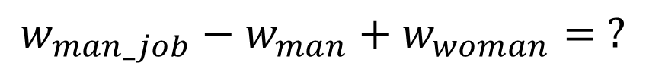
Word embedding biases
$$w_{man_job}−w_{man}+w_{woman}= ?$$
Important: A quick note on word embeddings biases.
As mentioned before, we value the quality of a word embedding by how good it manages to capture similarities and analogies between words, by extracting it from a given corpus.
Problem: if the corpus is biased (sexist, racist, etc.), it will catch these biases as well! (See [Bolukbasi2016]).

Slide 23
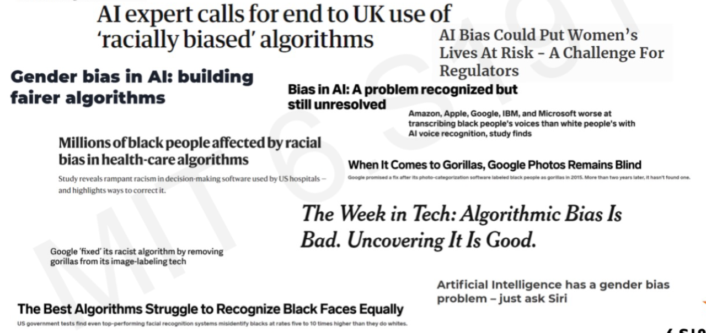
Word embedding biases
$$w_{man_job}−w_{man}+w_{woman}= ?$$
Important: A quick note on word embeddings biases.
As mentioned before, we value the quality of a word embedding by how good it manages to capture similarities and analogies between words, by extracting it from a given corpus.
Problem: if the corpus is biased (sexist, racist, etc.), it will catch these biases as well! (See [Bolukbasi2016]).

Slide 24
Word embeddings evaluation
Question: What makes a word embedding better than another?
How do we measure the performance of an embedding?
How do we decide on the best word embedding to use?
Answer: Still an open question at the moment…
No perfect qualitative method for evaluating Word Embeddings.
More of a “consensus”, which changes over the years.
Still a lot of work needed to come up with a “perfect” universal embedding (if that is even possible?)

Slide 25
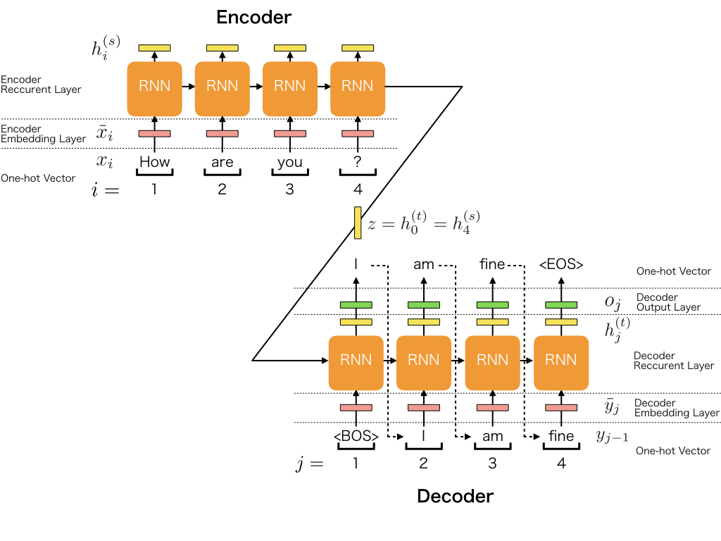
Sequence to sequence tasks
Definition (Seq2Seq):
A Sequence-to-Sequence task (Seq2Seq) is a family of machine learning tasks which turns an input sequence into another output sequence.
For instance, language to language translation (French sentence into an English sentence), answers to questions Chatbots, etc.

Slide 26
Sequence to sequence tasks
Definition (Encoder-Decoder architecture):
An Encoder-Decoder architecture typically consists of two parts:
An encoder, which converts a sequence into an embedding vector, presumably encapsulating the context of the sequence.
A decoder, which reads the embedding vector for context and constructs an output sequence.
Both the encoder and the decoder will be modeled as RNNs as they both operate on sequences.

Slide 27
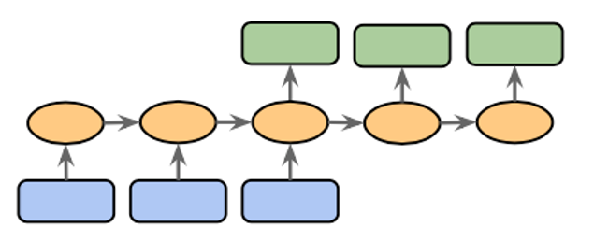
Encoder and Decoder models
Definition (encoder and decoder models):
In general, the first part of the model will focus on analysing the input, eventually producing a final memory vector output after having seen all inputs. This is called an encoder.
Can be done with a RNN of some sort, where the final memory state consists of the encoding vector.
E.g. read an English sentence, progressively encoding each word’s meaning, to obtain the entire sentence meaning in a single encoding vector.

Slide 28
Encoder and Decoder models
Definition (encoder and decoder models):
In general, the second part of the model will focus on analysing the produced encoding vector, and producing a sequence of some sort as output. This is called an decoder.
Can be done with the same (or another) RNN of some sort, where the first memory state consists of the encoding vector.
E.g. read an encoding vector describing an English sentence and produce an output sequence being the French translation.

Slide 29
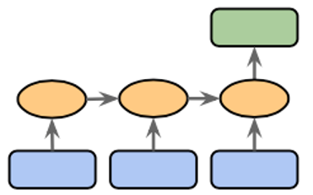
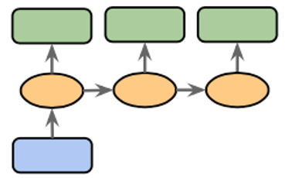
Encoder and Decoder models
Encoder model: can be seen as a (many-to-one) model of some sort, receiving a sequence as input and producing a single encoding vector as output.
Decoder model: would be a (one-to-many) model of some sort, receiving this single encoding vector as input and producing a sequence as output.

Slide 30
Encoder + Decoder = Seq2Seq?
Eventually both the encoder and the decoder models will assemble into a Seq2Seq model.

Slide 31
Sequence to sequence tasks
In the classical Seq2Seq architecture,
a word embedding is used for each word of the sentence,
An (often bi-directional RNN) encoder is used to propagate and encode context among words in the sentence,
A decoder RNN reads the context and produces a new sentence.

Slide 32
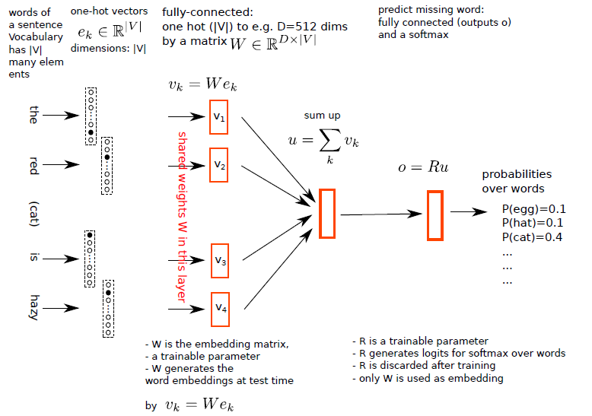
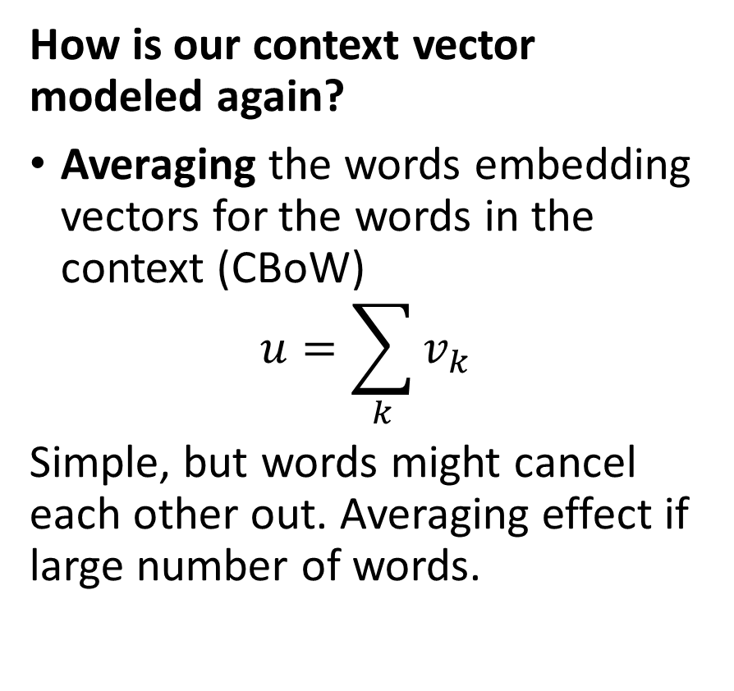
Sequence to sequence tasks
How is our context vector modeled again?
Averaging the words embedding vectors for the words in the context (CBoW)
$$u=\sum_{k}{v_{k}}$$
Simple, but words might cancel each other out. Averaging effect if large number of words.

Slide 33
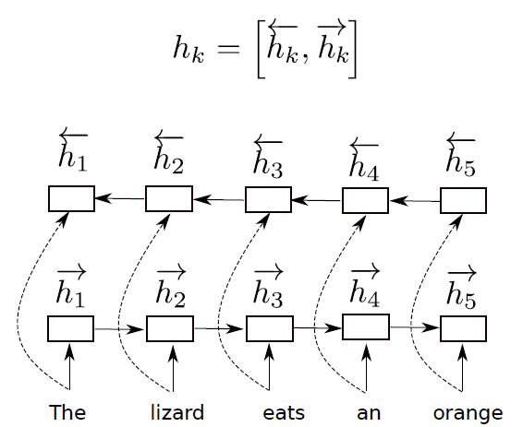
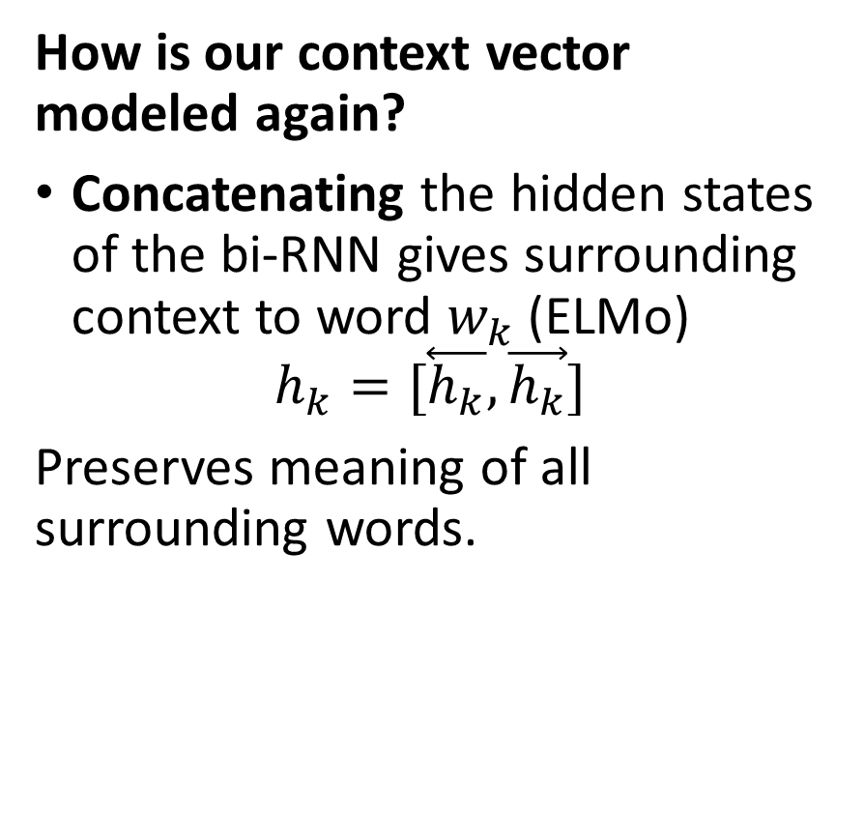
Sequence to sequence tasks
How is our context vector modeled again?
Concatenating the hidden states of the bi-RNN gives surrounding context to word $w_{k}$ (ELMo)
$$h_{k}=[\overset{⃖}{h_{k}},\vec{h_{k}}]$$
Preserves meaning of all surrounding words.

Slide 34
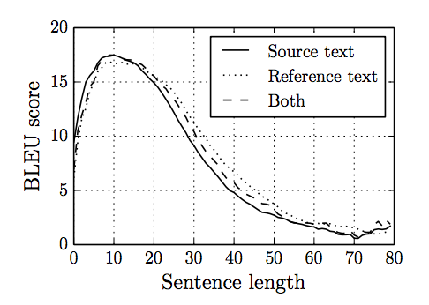
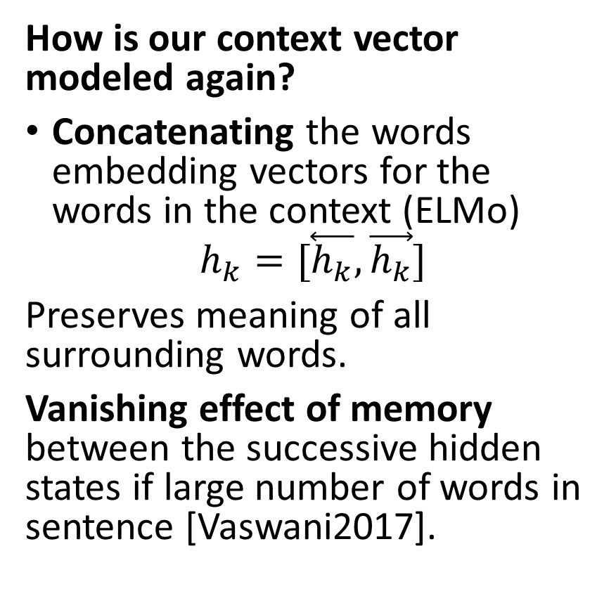
Sequence to sequence tasks
How is our context vector modeled again?
Concatenating the words embedding vectors for the words in the context (ELMo)
$$h_{k}=[\overset{⃖}{h_{k}},\vec{h_{k}}]$$
Preserves meaning of all surrounding words.
Vanishing effect of memory between the successive hidden states if large number of words in sentence [Vaswani2017].
Curves are variations of Seq2Seq architectures.
Context Accuracy Score
Sentence Length
From: https://www.kaggle.com/sarthakvajpayee/attention-mechanism-japanese-english/notebook

Slide 35
Sequence to sequence tasks
What is the reason for the loss of context meaning in large sentences?
Words that are far away from each other will have their context lost by the hidden state of the LSTM RNN.
For instance,
“Paris was a universe whole and entire unto herself, hollowed and fashioned by history; so she seemed in this age of Napoleon III with her towering buildings, her massive cathedrals, her grand boulevards, and ancient winding medieval streets–as vast and indestructible as nature itself. All was embraced by her, by her volatile and enchanted populace thronging the galleries, the theaters, the cafes, giving birth over and over to genius and sanctity, philosophy and war, frivolity and the finest art; so it seemed that if all the world outside her were to sink into darkness, what was fine, what was beautiful, what was essential might there still come to its finest flower.“

Slide 36
Sequence to sequence tasks
What is the reason for the loss of context meaning in large sentences?
Words that are far away from each other will have their context lost by the hidden state of the LSTM RNN.
For instance,
“Paris was a universe whole and entire unto herself, hollowed and fashioned by history; so she seemed in this age of Napoleon III with her towering buildings, her massive cathedrals, her grand boulevards, and ancient winding medieval streets–as vast and indestructible as nature itself. All was embraced by her, by her volatile and enchanted populace thronging the galleries, the theaters, the cafes, giving birth over and over to genius and sanctity, philosophy and war, frivolity and the finest art; so it seemed that if all the world outside her were to sink into darkness, what was fine, what was beautiful, what was essential might there still come to its finest flower.“

Slide 37
Sequence to sequence tasks
What is the reason for the loss of context meaning in large sentences?
Words that are far away from each other will have their context lost by the hidden state of the LSTM RNN.
For instance,
“Paris was a universe whole and entire unto herself, hollowed and fashioned by history; so she seemed in this age of Napoleon III with her towering buildings, her massive cathedrals, her grand boulevards, and ancient winding medieval streets–as vast and indestructible as nature itself. All was embraced by her, by her volatile and enchanted populace thronging the galleries, the theaters, the cafes, giving birth over and over to genius and sanctity, philosophy and war, frivolity and the finest art; so it seemed that if all the world outside her were to sink into darkness, what was fine, what was beautiful, what was essential might there still come to its finest flower.“

Slide 38
Sequence to sequence tasks
What is the reason for the loss of context meaning in large sentences?
Words that are far away from each other will have their context lost by the hidden state of the LSTM RNN.
Can we train our Neural Networks to get a better grasp of the important words that matter in the sequence and how to connect them, even when far away from each other?
Yes!
That is exactly what the attention layer does!

Slide 39
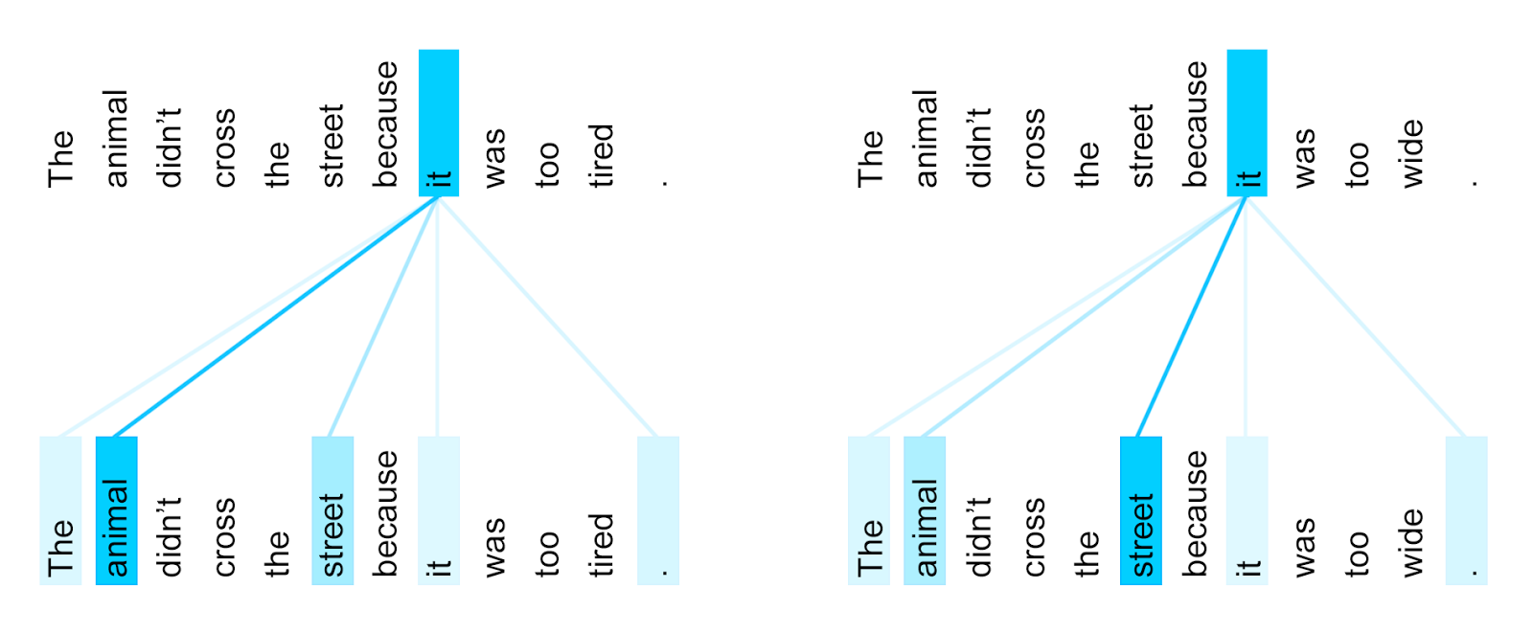
Attention: definition and motivation
Definition (attention):
In the context of neural networks, attention (as introduced in [Vaswani2017]) is a technique that mimics cognitive attention.
The effect enhances the important parts of the input data and fades out the rest.
The thought being that the network should devote more computing power on that small but important part of the data.

Slide 40
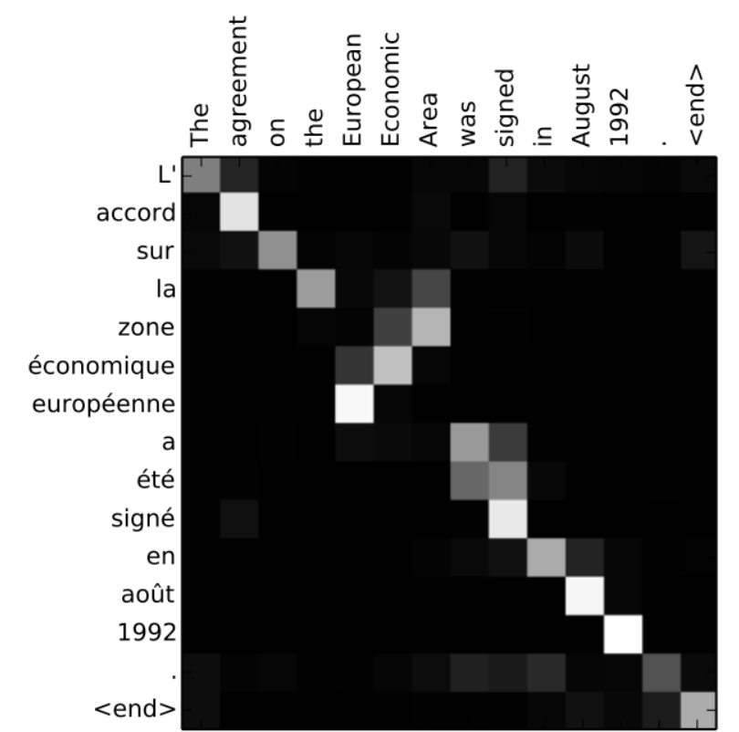
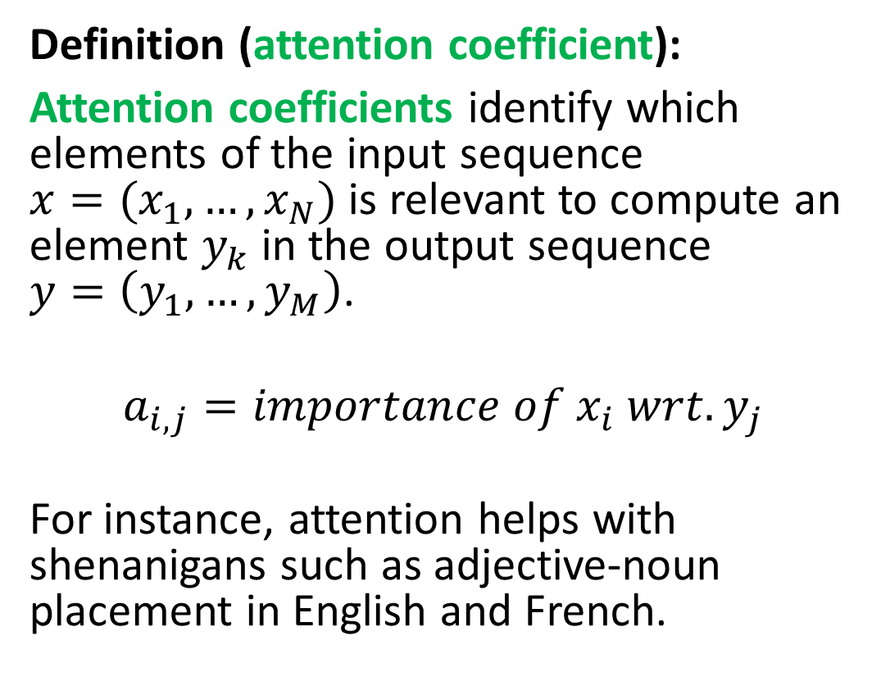
Attention coefficients
Definition (attention coefficient):
Attention coefficients identify which elements of the input sequence $x=(x_{1},…,x_{N})$ is relevant to compute an element $y_{k}$ in the output sequence $y=\left(y_{1},…,y_{M}\right)$.
$$a_{i,j}=importance of x_{i} wrt.y_{j}$$
For instance, attention helps with shenanigans such as adjective-noun placement in English and French.

Slide 41
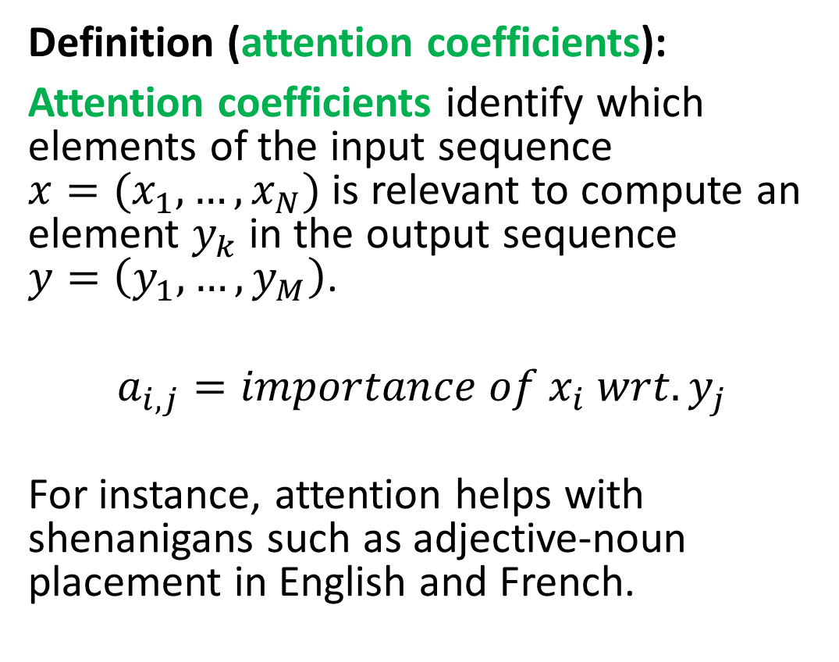
Attention coefficients
“Paris was a universe whole and entire unto herself, hollowed and fashioned by history; so she seemed in this age of Napoleon III with her towering buildings, her massive cathedrals, her grand boulevards, and ancient winding medieval streets–as vast and indestructible as nature itself. All was embraced by her, by her volatile and enchanted populace thronging the galleries, the theaters, the cafes, giving birth over and over to genius and sanctity, philosophy and war, frivolity and the finest art; so it seemed that if all the world outside her were to sink into darkness, what was fine, what was beautiful, what was essential might there still come to its finest flower.“
Definition (attention coefficients):
Attention coefficients identify which elements of the input sequence $x=(x_{1},…,x_{N})$ is relevant to compute an element $y_{k}$ in the output sequence $y=\left(y_{1},…,y_{M}\right)$.
$$a_{i,j}=importance of x_{i} wrt. y_{j}$$
For instance, attention helps with shenanigans such as adjective-noun placement in English and French.

Slide 42
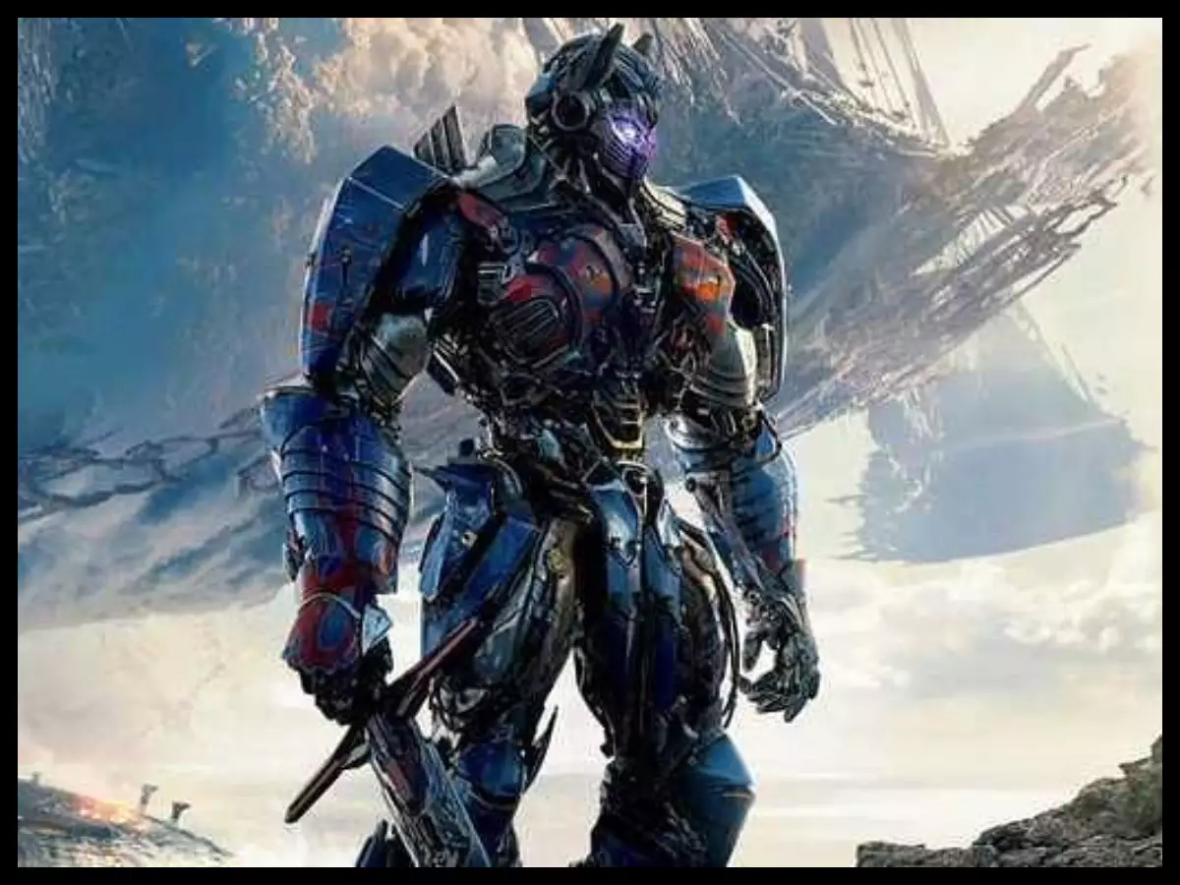
Attention: definition and motivation
Definition (transformer):
A transformer network make extensive use of attention mechanisms and more specifically attention layers to achieve their expressive power.
Transformers are currently considered as one of the most promising directions for Computer Vision, and Natural Language Processing.
Figure 27: Don’t you even think about it. Seriously, don’t.

Slide 43
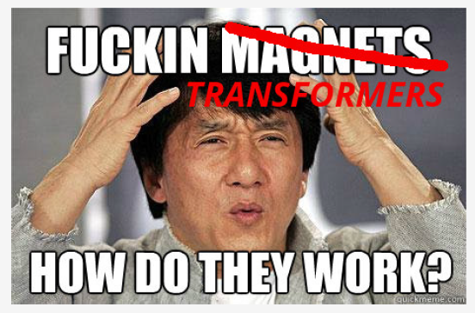
The attention layer
But first, a disclaimer from our beloved SUTD sponsor.
Definition (the transformer architecture):

Slide 44


Slide 45
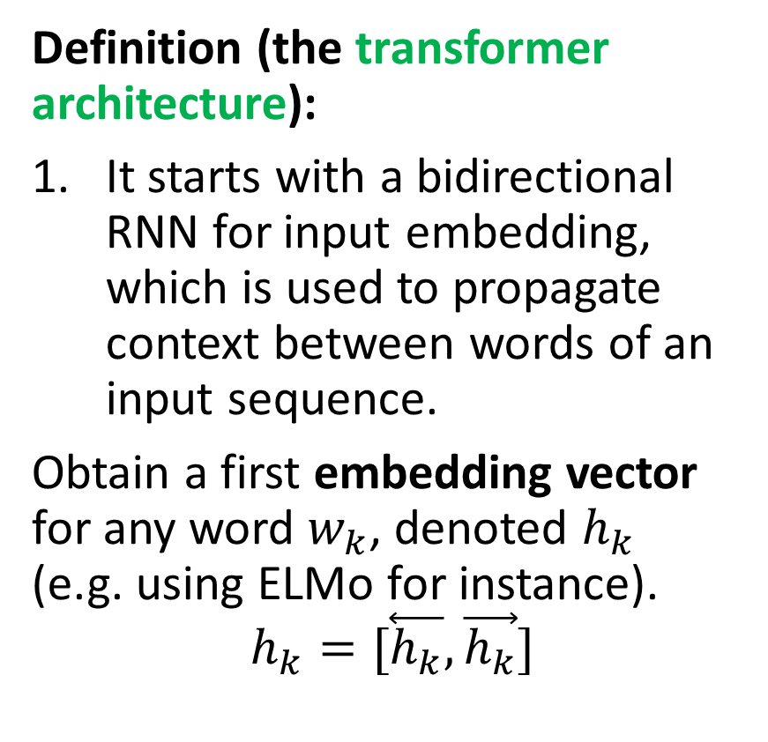
The attention layer
Definition (the transformer architecture):
It starts with a bidirectional RNN for input embedding, which is used to propagate context between words of an input sequence.
Obtain a first embedding vector for any word $w_{k}$, denoted $h_{k}$ (e.g. using ELMo for instance).
$$h_{k}=[\overset{⃖}{h_{k}},\vec{h_{k}}]$$

Slide 47
The attention layer
Definition (the transformer architecture):
If you observe, the self-attention computations we will define later have no notion of the ordering of words among the sequences.
This is where positional encoding comes into play.
(However, out-of-scope for this class, will be skipped).
Core idea: Some languages have different positioning of words in sentences (Japanese tends to put verbs at the end of sentence, French tends to place adjectives after nouns, etc.)
To elicit this notion of positioning of words in the sequence, positional encoding can be added to the regular input embeddings.

Slide 49
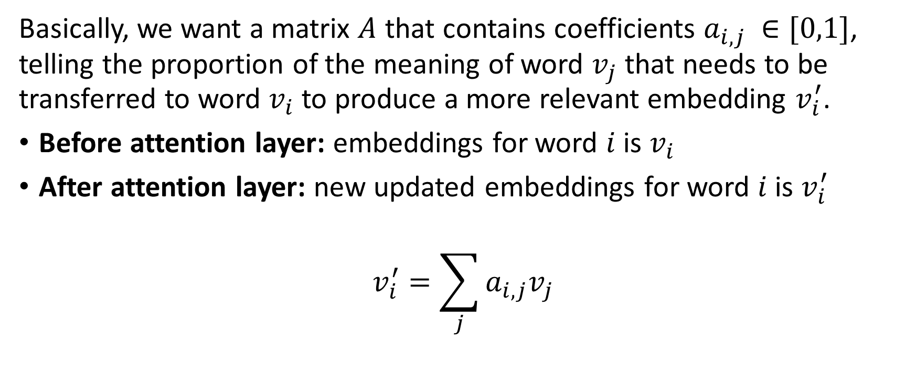
The attention layer
Basically, we want a matrix $A$ that contains coefficients $a_{i,j }∈[0,1]$, telling the proportion of the meaning of word $v_{j}$ that needs to be transferred to word $v_{i}$ to produce a more relevant embedding $v_{i}^{′}$.
Before attention layer: embeddings for word $i$ is $v_{i}$
After attention layer: new updated embeddings for word $i$ is $v_{i}^{′}$
$$v_{i}^{′}=\sum_{j}{a_{i,j}v_{j}}$$

Slide 50
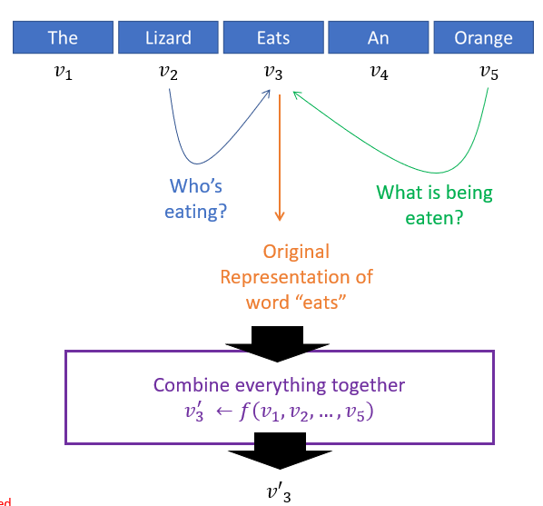
The attention layer
Basically, we want a matrix $A$ that contains coefficients $a_{i,j }∈[0,1]$, telling the proportion of the meaning of word $v_{j}$ that needs to be transferred to word $v_{i}$ to produce a more relevant embedding $v_{i}^{′}$.
Before attention layer: embeddings for word $i$ is $v_{i}$
After attention layer: new updated embeddings for word $i$ is $v_{i}^{′}$
$$v_{i}^{′}=\sum_{j}{a_{i,j}v_{j}}$$

Slide 51
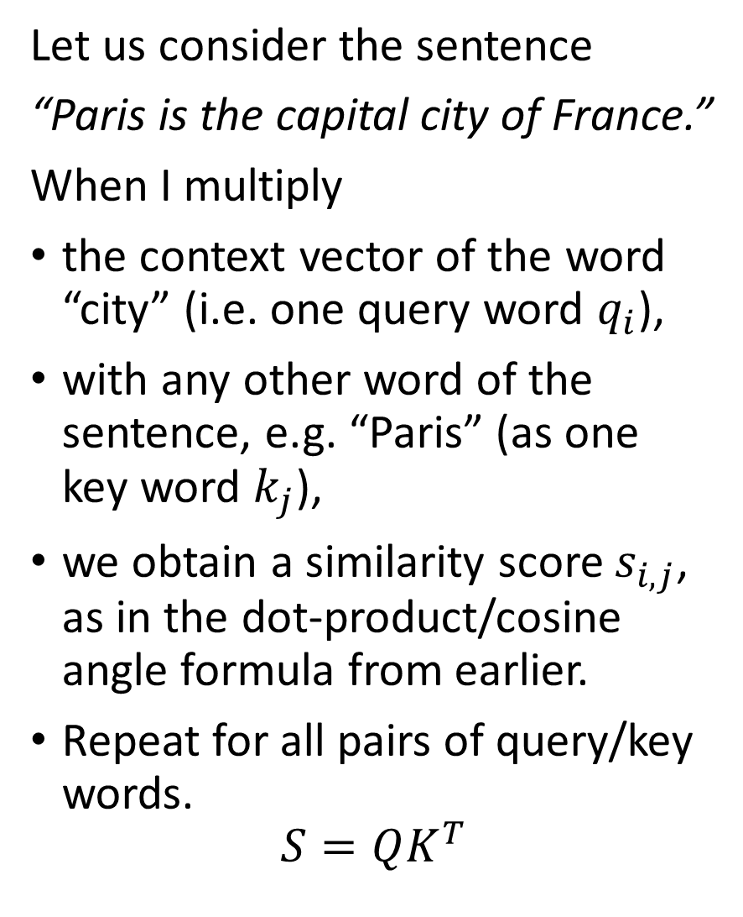
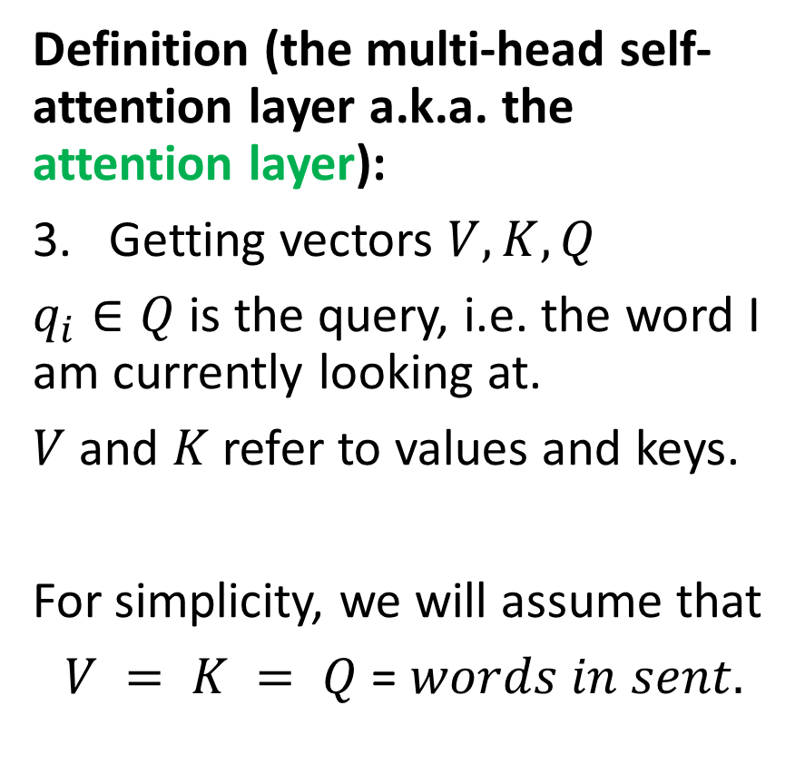
The attention layer
Let us consider the sentence
“Paris is the capital city of France.”
When I multiply
the context vector of the word “city” (i.e. one query word $q_{i}$),
with any other word of the sentence, e.g. “Paris” (as one key word $k_{j}$),
we obtain a similarity score $s_{i,j}$, as in the dot-product/cosine angle formula from earlier.
Repeat for all pairs of query/key words.
$$S=QK^{T}$$
Definition (the multi-head self-attention layer a.k.a. the attention layer):
Getting vectors $V, K, Q$
$q_{i}∈Q$ is the query, i.e. the word I am currently looking at.
$V$ and $K$ refer to values and keys.
For simplicity, we will assume that
$V = K = Q$ = $words in sent.$

Slide 53
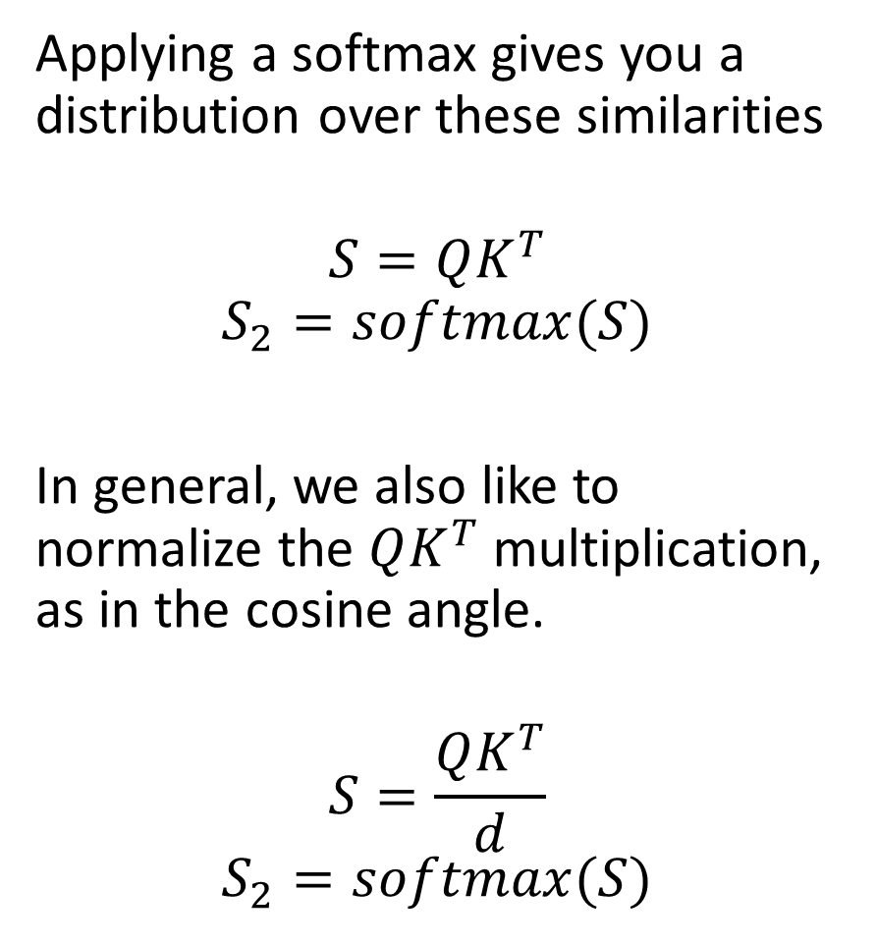
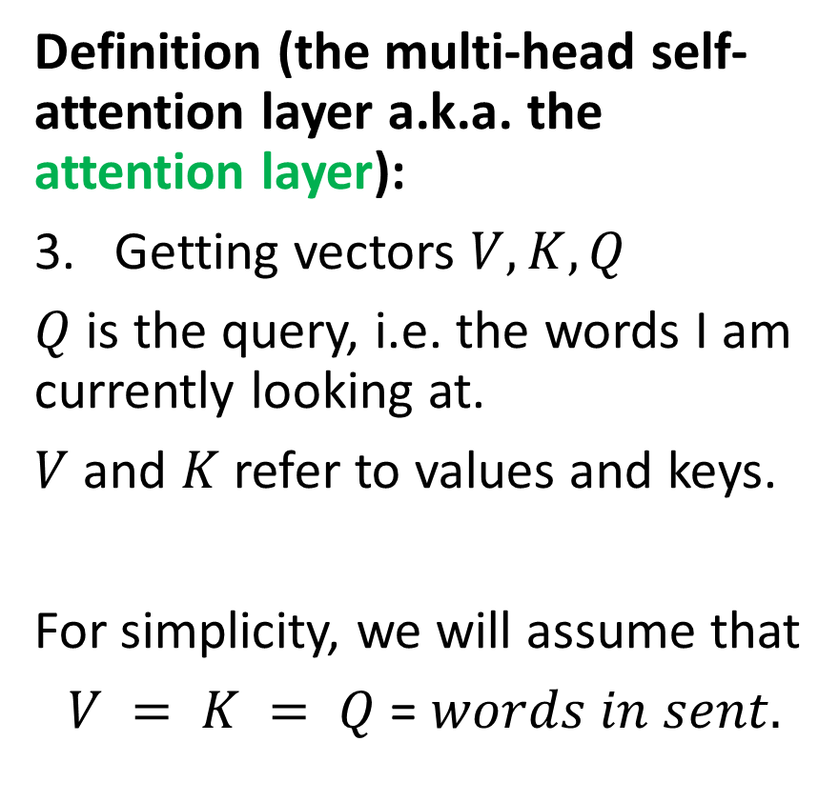
The attention layer
Applying a softmax gives you a distribution over these similarities
$$S=QK^{T}$$
$$S_{2}=softmax(S)$$
In general, we also like to normalize the $QK^{T}$ multiplication, as in the cosine angle.
$$S=\frac{QK^{T}}{d}$$
$$S_{2}=softmax(S)$$
Definition (the multi-head self-attention layer a.k.a. the attention layer):
Getting vectors $V, K, Q$
$Q$ is the query, i.e. the words I am currently looking at.
$V$ and $K$ refer to values and keys.
For simplicity, we will assume that
$V = K = Q$ = $words in sent.$

Slide 54
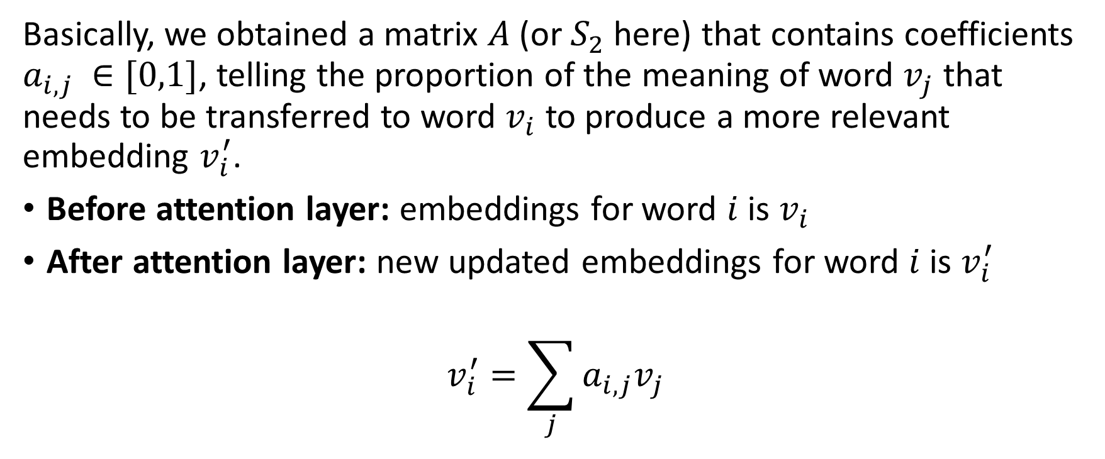
The attention layer
Basically, we obtained a matrix $A$(or $S_{2}$here) that contains coefficients $a_{i,j }∈[0,1]$, telling the proportion of the meaning of word $v_{j}$ that needs to be transferred to word $v_{i}$ to produce a more relevant embedding $v_{i}^{′}$.
Before attention layer: embeddings for word $i$ is $v_{i}$
After attention layer: new updated embeddings for word $i$ is $v_{i}^{′}$
$$v_{i}^{′}=\sum_{j}{a_{i,j}v_{j}}$$

Slide 55
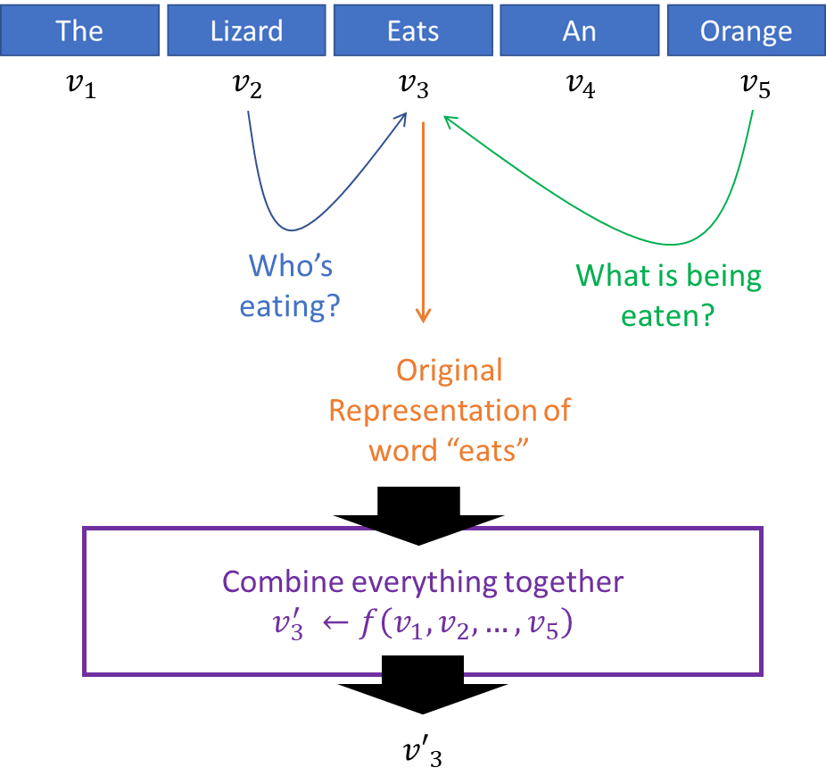

Slide 56
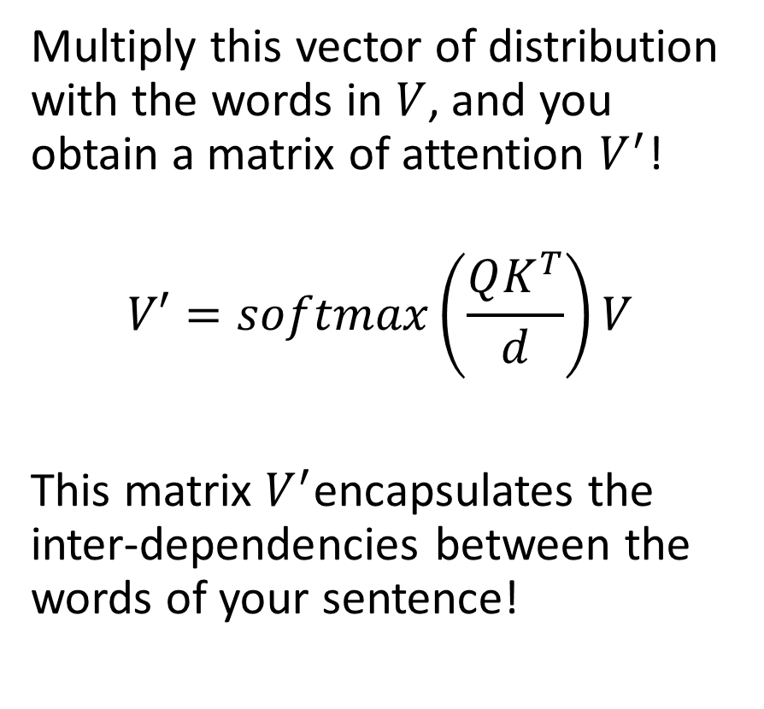
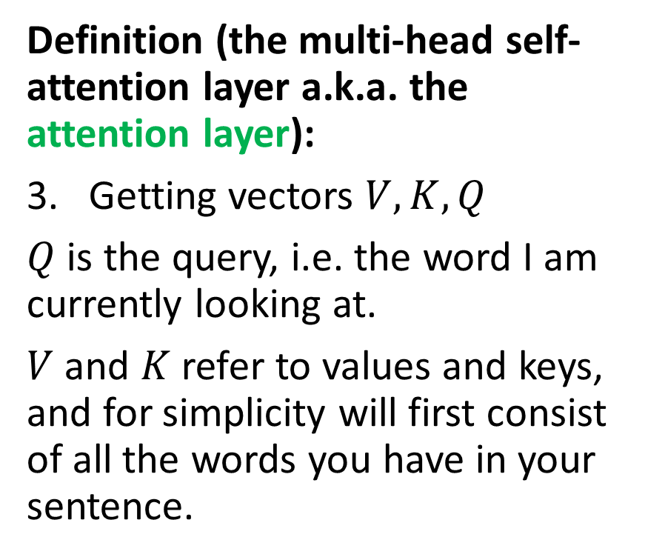
The attention layer
Definition (the multi-head self-attention layer a.k.a. the attention layer):
Getting vectors $V, K, Q$
$Q$ is the query, i.e. the word I am currently looking at.
$V$ and $K$ refer to values and keys, and for simplicity will first consist of all the words you have in your sentence.
Multiply this vector of distribution with the words in $V$, and you obtain a matrix of attention $V^{′}$!
$$V′=softmax\left(\frac{QK^{T}}{d}\right)V$$
This matrix $V^{′}$encapsulates the inter-dependencies between the words of your sentence!

Slide 57
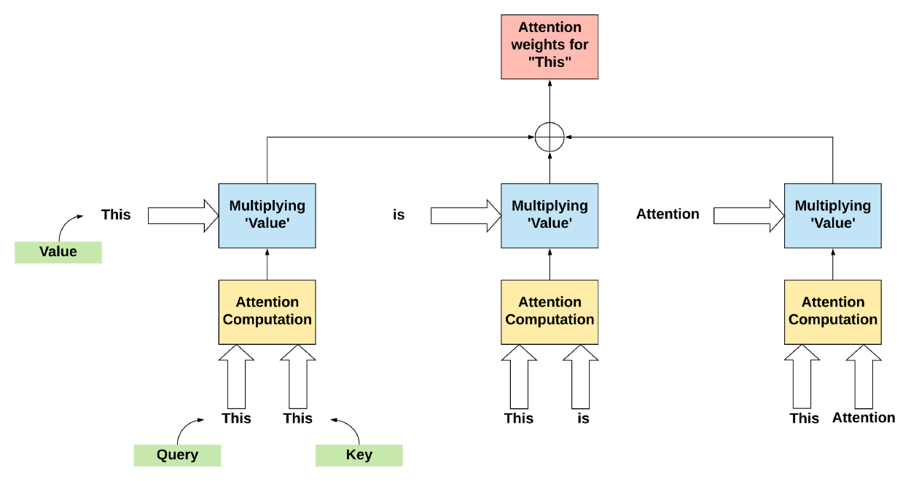

Slide 58
The attention layer
Definition (the multi-head self-attention layer a.k.a. the attention layer):
Getting vectors $V, K, Q$
$Q$ is the query, i.e. the words I am currently looking at.
$V$ and $K$ refer to values and keys.
For simplicity, we will assume that
$V = K = Q$ = $words in sent.$
This calculation is often referred to as self-attention, as it gives inter-dependencies between the words of a single sentence.

Slide 59
V, K and Q are the same here

Slide 61
The attention layer
Definition (the multi-head self-attention layer a.k.a. the attention layer):
Masking is only used in the decoder part (and it will be discussed later).

Slide 63
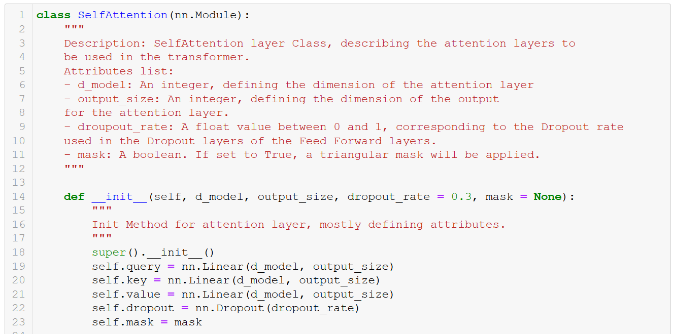

Slide 64
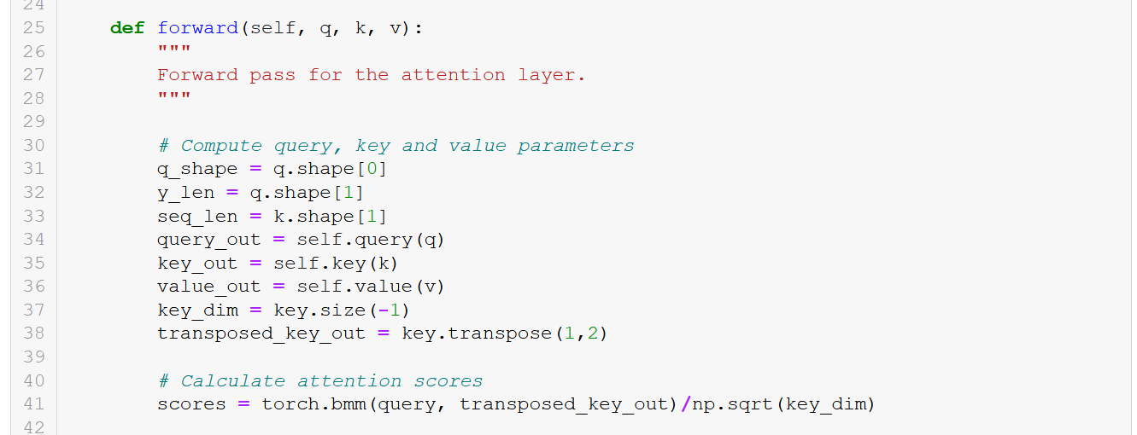
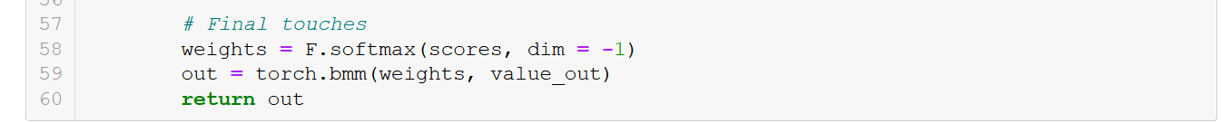
(masking part to be discussed later)

Slide 65
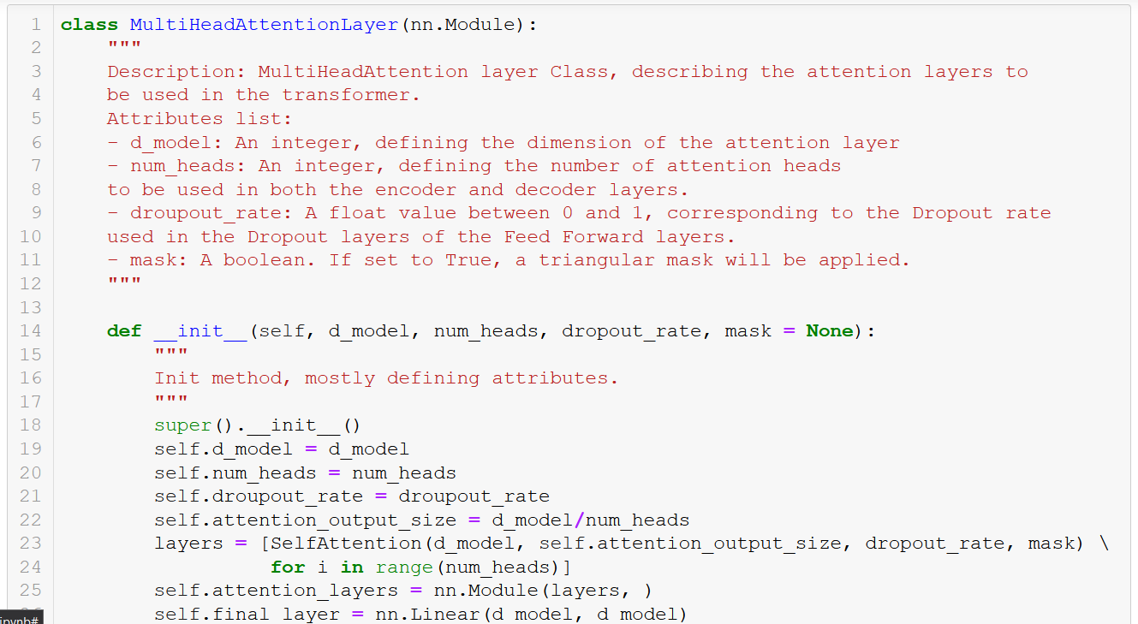

Slide 66
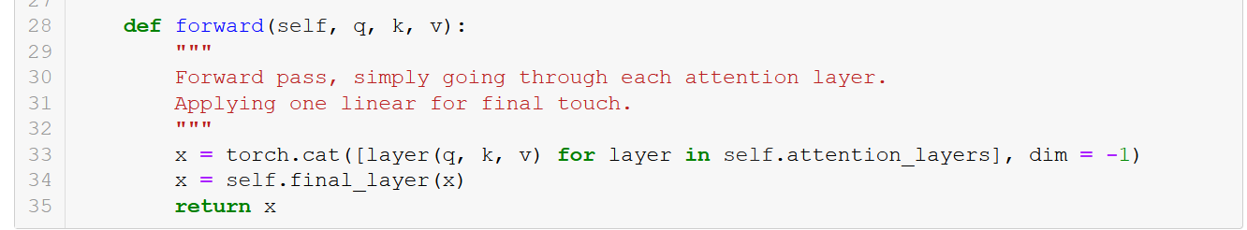

Slide 67
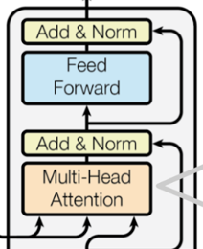
The attention layer
Definition (the multi-head self-attention layer a.k.a. the attention layer):
Feedforward is a set of linear/fully connected layers, whose main purpose is to reshape the attention vectors so that it is acceptable by the next encoder or decoder layer. Also uses a skip/residual connection as in ResNet!

Slide 68
ONE ENCODER LAYER

Slide 69
FULL
ENCODER

Slide 70
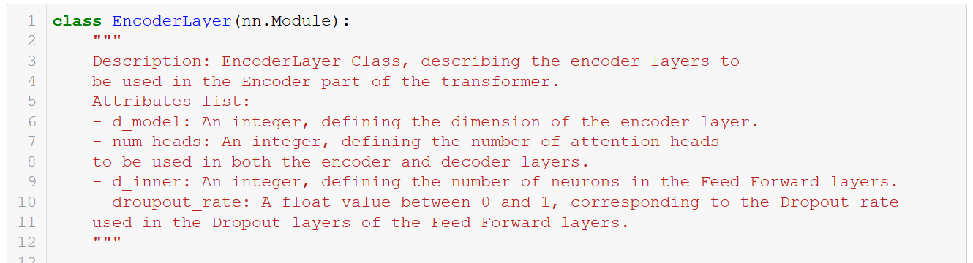

Slide 71
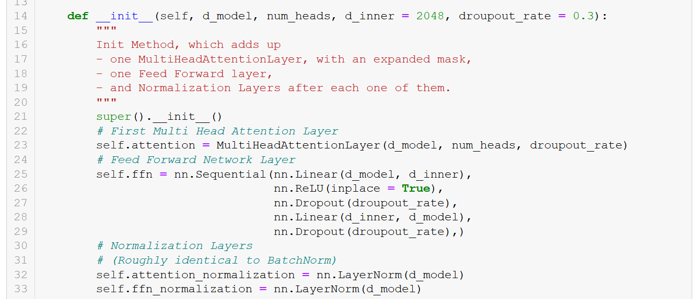

Slide 72


Slide 73


Slide 74
DECODER

Slide 75
The attention layer
While generating target sequences at the decoder, since the transformer uses self-attention, it tends to include all the words from the decoder inputs.
But, practically, this is incorrect and “cheating” for the network.
The transformer must not use the current or future output to predict the next one, so the output sequence must be partially masked to prevent this reverse information flow.
Masking Multi-Head Attention ensures this.
Definition (the multi-head self-attention layer a.k.a. the attention layer):
Same multi-head block as before but with masking this time! Why masking?

Slide 76

The attention layer
Definition (the multi-head self-attention layer a.k.a. the attention layer):
Same multi-head block as before but with masking this time! Why masking?
While generating target sequences at the decoder, since the transformer uses self-attention, it tends to include all the words from the decoder inputs.
But, practically this is incorrect. Only the words preceding the current word may contribute to the generation of the next word.
Masked Multi-Head Attention ensures this.

Slide 77

(Extra step in the attention layer class, forward method!)
Note: I played around with a few different masks, just for fun. Paper suggests to use the triu (upper triangular) mask.

Slide 78
DECODER BLOCK!

Slide 79

The attention layer
Definition (the multi-head self-attention layer a.k.a. the attention layer):
The second attention block is special as it uses $V$ and $K$ from the encoder part and $Q$ from the decoder part.
$$A=softmax\left(\frac{QK^{T}}{d}\right)V$$

Slide 80
The attention layer
Definition (the multi-head self-attention layer a.k.a. the attention layer):
Repeat the attention block (multi-head attention + add/norm + feed forward) a few times.
Finish with a fully connected and softmax giving probabilities for the words in each position of the output sequence!

Slide 81


Slide 82


Slide 83


Slide 84


Slide 85

The attention layer
Definition (the multi-head self-attention layer a.k.a. the attention layer):
Train it with a dataset consisting of several pairs $(x,y)$of sentences. For instance, chatbot with $x$ being question prompts and $y$ being expected answers.
Or translation with $x$ and $y$ being sentences in two different languages, etc…

Slide 86
Time to assemble everything!

Slide 87


Slide 88



Slide 89
And, done!
Phew, that was tough!

Slide 90

Well, at the end of the day, it is “just” matrix multiplications…

Slide 91

Great news!
A recent release of PyTorch COMES WITH TRANSFORMERS CLASSES!
https://pytorch.org/docs/stable/generated/torch.nn.Transformer.html

Slide 92
Applications for attention/transformers
In NLP: Sentences are typical examples of sequences where computing attention coefficients make sense as a way to help with contextualization.
Other applications for attention exist, typically with images, where attention coefficients can help understand how pixels interact with each other! Technically attention layers could “replace” CNNs!
Or how pixels could affect a caption decision (image and video captioning, handwritten recognition, etc.)
Will also be used in graphs next week!

Slide 93

The BERT word embedding
Why discuss transformers during this (long) lecture on embeddings?
Well, let us assume we train a transformer for a meaningless linguistics task…
Can we extract the encoder part, as we did with all the unsupervised approaches to word embedding (CBoW, SkipGram, FastText, ELMo)?
Yes! And you obtain one of the current best word embeddings, BERT and GPT! [Devlin2019]!
Python package: https://pypi.org/project/bert-embedding/

Slide 94

Also, GPT-n embeddings
On another note, OpenAI has also produced an important embedding, also relying on transformers, called GPT-3 [Brown2020][GPT-3].
GPT, being the acronym for Generative Pretrained Transformer.
Similar to BERT, it is also considered one of the current state-of-the-art embeddings.

Slide 95
GPT3 and ChatGPT
In fact, GPT3 (and even 4!) is the encoder model that is used in ChatGPT to process the text prompt you have entered!
This encoding vector is later passed to a decoder, whose objective is to produce an answer to your text prompt, in the form of a text sequence!
Moving closer and closer to understanding ChatGPT fully, but more concepts are needed for the decoder part!
(Something for later!)

Slide 96
A pointer on GPT-4
Speaking of, the next state-of-the-art embedding, GPT-4, is coming!
Announced on March 9th, 2023, and got released in April 2023!
https://openai.com/research/gpt-4
GPT-4 is expected to have a (much) larger number of parameters, allowing it to model even more complex patterns in natural language.
It may also incorporate new techniques or architectural improvements that could lead to better performance on specific tasks or improved efficiency.

Slide 97
Can we use Transformers for MNIST?
Definition (Vision Transformer model):
A Vision Transformer model (ViT) is a neural network architecture that applies the transformer ideas and attention layers, originally introduced for natural language processing, to image classification tasks.
Often using attention layers in place of, or – even better – combined with, the typical image convolutional operations.
This is a typical example of how an idea from a field (here, NLP) can be stolen and reused in a completely different field (here, Computer Vision!).

Slide 98

Implementing a self-attention layer (short)

Slide 99

Implementing a simple vision transformer
Our MNIST transformer
Linear(28*28, 128) to be used on flattened images,
Self-attention,
Linear(128, 64),
Self-attention again,
Linear(64, 10), to get the right number of classes,
ReLU activations after each Linear except the last one.

Slide 100

Will it train?

Slide 101


Will it train? Yes, and it seems to do ok!
Seems to train nicely!
Using attention layers in Computer Vision tasks seems to be a thing?!

Slide 102

Open question
Question: Can we get better performance by combining convolutions (preferred operations for images) and attentions operations?

Slide 103

Out-of-NLP applications for transformers: Image captioning

Slide 104

Out-of-NLP applications for transformers: Video captioning

Slide 105

Out-of-NLP applications for transformers: Handrwitten recognition

Slide 106
Conclusion (W9S3)
We have seen a few approaches to embeddings.
Train an AI to figure out embeddings?
Basic approaches.
Out of dictionary entries?
Use ELMo or FastText!
(Alternative supervised methods?)
(Supervised: InferSent)
(Multi-task: Google’s Universal Embedding.)
A few more problems are still open at the moment for these word embeddings.
Can these embedding be biased? Yes, unfortunately, active research on this.
Can we help the network in computing context? Yes, with attention and transformers!
Best word embedding at the moment? Probably GPT4!

Slide 107
Learn more about these topics
Out of class, for those of you who are curious
[Schnabel2015] Schnabel et al., “Evaluation methods for unsupervised word embeddings”, 2015. https://www.aclweb.org/anthology/D15-1036/
[Bolukbasi2016] Bolukbasi et al., “Man is to Computer Programmer as Woman is to Homemaker? Debiasing Word Embeddings”, 2016. https://arxiv.org/abs/1607.06520
[Vaswani2017] Vaswani et al., “Attention Is All You Need”, 2017. https://arxiv.org/abs/1706.03762

Slide 108
Learn more about these topics
Out of class, for those of you who are curious
[Conneau2018] Conneau et al., “Supervised Learning of Universal Sentence Representations from Natural Language Inference Data”, 2018. https://arxiv.org/abs/1705.02364
[Cer2019] Cer et al., “Universal Sentence Encoder”, 2019. https://arxiv.org/abs/1803.11175
[Wang2018] Wang et al., “GLUE: A Multi-Task Benchmark and Analysis Platform for Natural Language Understanding” https://arxiv.org/abs/1804.07461

Slide 109
Learn more about these topics
Out of class, for those of you who are curious
[Devlin2019] Devlin et al., “BERT: Pre-training of Deep Bidirectional Transformers for Language Understanding”, 2019. https://arxiv.org/abs/1810.04805
[Brown2020] Brown et al. (20 of them or so), “Language Models are Few-Shot Learners”, 2020. https://arxiv.org/abs/2005.14165

Slide 110
Learn more about these topics
Out of class, for those of you who are curious
[Dong2021] Dong et al., “Attention is Not All You Need: Pure Attention Loses Rank Doubly Exponentially with Depth”, 2021. https://arxiv.org/abs/2103.03404
[Bello2021] Bello et al., “LambdaNetworks: Modeling Long-Range Interactions Without Attention”, 2021. https://arxiv.org/abs/2102.08602

Slide 111
Learn more about these topics
Out of class, for those of you who are curious
[GPT-3] Read more about GPT-3and OpenAI, here: https://www.vox.com/future-perfect/21355768/gpt-3-ai-openai-turing-test-language https://www.technologyreview.com/2020/07/20/1005454/openai-machine-learning-language-generator-gpt-3-nlp/
[Forbes-GPT4] Read more about the GPT-4 model, next big update and future candidate for the state-of-the-art of language models, in this article, here (but more importantly, track it and do not miss it): https://www.forbes.com/sites/bernardmarr/2023/02/24/gpt-4-is-coming--what-we-know-so-far/

Slide 112
Learn more about these topics
Out of class, for those of you who are curious
[GPT4OAI] The GPT-4 announcement from Open AI (made today, as of March 15th 2023!) https://openai.com/research/gpt-4
[Cohere] A great article about word and sentence embeddings with cool visualization. https://txt.cohere.ai/sentence-word-embeddings/

Slide 113
Learn more about these topics
Tracking important names (Track their works and follow them on Scholar, Twitter, or whatever works for you!)
Alexis Conneau: Senior Researcher at Google. https://scholar.google.fr/citations?user=45KfCpgAAAAJ&hl=fr
Daniel Cer: Researcher at Google and Lecturer at UC Berkeley. He has a really good course about NLP and Embeddings. https://scholar.google.com/citations?user=BrT1NW8AAAAJ&hl=en https://www.ischool.berkeley.edu/user/4406 https://www.ischool.berkeley.edu/courses/datasci/266

Slide 114
Learn more about these topics
Tracking important names (Track their works and follow them on Scholar, Twitter, or whatever works for you!)
Tobias Schnabel: Senior researcher at Microsoft. https://scholar.google.com/citations?user=o_i419UAAAAJ&hl=en https://www.microsoft.com/en-us/research/people/toschnab
Tolga Bolukbasi: Senior researcher at Google Brain. https://scholar.google.com/citations?user=3rF9gtAAAAAJ&hl=en
Anish Vaswani: Researcher at Google Brain. Highest cited paper in DL. https://scholar.google.com/citations?user=oR9sCGYAAAAJ&hl=en
Jacob Devlin: Researcher at Google. https://research.google/people/106320/

Slide 115
Learn more about these topics
Tracking important names (Track their works and follow them on Scholar, Twitter, or whatever works for you!)
Greg Brockman: CEO of OpenAI. https://gregbrockman.com/ https://dblp.org/pid/74/10715.html
Sam Altman: Former CEO of OpenAI, still involved in research. Very active on Twitter and technically, the social media face of OpenAI? https://blog.samaltman.com/

Slide 116
Learn more about these topics
Tracking important names (Track their works and follow them on Scholar, Twitter, or whatever works for you!)
Alec Radford: Former research scientist at OpenAI and was one of the primary authors of the GPT. Also worked on Dall-E. https://scholar.google.com/citations?user=dOad5HoAAAAJ&hl=en https://openai.com/blog/authors/alec/
OpenAI: The company behind ChatGPT. Already mentioned it on W4S2. https://openai.com/

Slide 117
In the last episode…
We have discussed the embedding problem, and its aspects in Natural Language Processing.
Many approaches can be used to obtain word embedding.
Unsupervised: CBoW & SkipGram (2013), GloVe (2014), FastText (2018), ELMo (2018).
All tasks we investigated were a sequence-to-singular output (CBoW) or singular input-to-sequence tasks (SkipGram).

Slide 118
Supervised and combined learning?
Word2Vec, GloVe and ELMo approaches are commonly referred to as unsupervised (or semi-supervised) approaches to embedding, both relying on the distributional hypothesis we mentioned on the previous lecture.
Unsupervised representation learning of sentences had been the norm for quite some time.
More advanced versions of unsupervised approaches exist!
However, the last few years have seen a shift toward supervised and multi-task learning schemes with a number of notably interesting proposals in late 2017/early 2018.

Slide 119
From unsupervised to combined learning
For a long time, there was a general consensus (see [Wang2018] for details) in the field that
the simple approach of simply averaging a sentence’s word vectors (as in CBoW approach) gives a strong baseline for context, which is good enough for many downstream tasks.
supervised learning of sentence/word embeddings was costly and gave lower-quality embeddings than unsupervised/semi-supervised approaches.
But these assumptions have recently been overturned, in part following the publication of the InferSent ([Conneau2018]) results.

Slide 120


Counter-example: InferSent (out-of-class)
Simple key takeaways
The InferSent model (in [Conneau2018]) is an example of a supervised classification model, with three classes: Entailment, Neutral, Contradiction.
It uses the same forward-backward LSTM architecture as ELMo, and attempts to compare two sentences and classify the pair.
Feature representation extracted from model showed good performance.

Slide 121
From unsupervised to combined learning
Following these recent results, showing that supervised approaches are not necessarily bad…
The current direction in research for word embeddings suggests to combine both supervised and unsupervised learning techniques. This is commonly referred to as a multi-task learning based embedding.
The most notable work in this direction would be Google’s Universal Sentence and Word Encoder (in [Cer2019]). Kept rather hidden, have only seen a pre-release on Tensorflow: https://www.tensorflow.org/hub/tutorials/semantic_similarity_with_tf_hub_universal_encoder
(But nothing for PyTorch yet?)

Slide 122
On the limits of attention?
Active research following the BERT and GPT embeddings, wondering what might be the next big revolution? ([Devlin2019])
In the paper [Dong2021], a research team from Google and EPFL proposed a novel approach that sheds light on the operation and inductive biases of self-attention/transformer networks and finds that pure attention performance decays in rank doubly exponentially with respect to depth.
Recent works suggest that a new type of transformer layer, called Lambda layers could become the next hype for the future of NLP embeddings [Bello2021]?
Or simply GPT-4? ([Forbes-GPT4]).

